Slide 1
This is a hidden slide
Dear honorable teacher please follow the instructions that has given in the slide notes (under the every slide). It would be helpful to take a successful class. Thanks a lot. I wish you good luck.

Slide 2
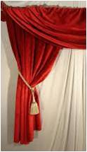
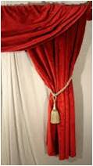

Welcome to my Class
Notes:
Teacher can greet it orally.

Slide 3
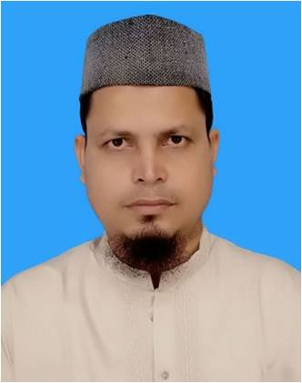

Introduction
S.K. Md. Harunar Rashid
Senior Teacher
Sonatola Model High School
Sonatola, Bogra.
English For Today
Class : 9 + 10
Notes:
Teacher can hide this slide.

Slide 4
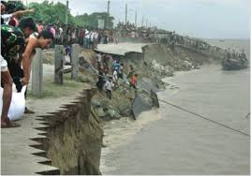
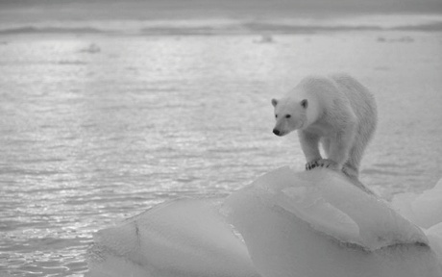
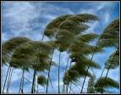
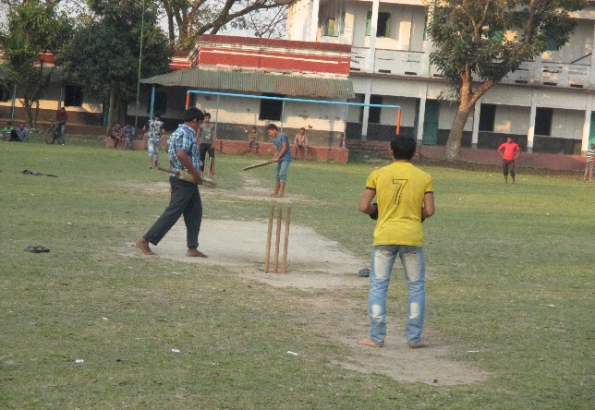
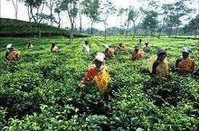
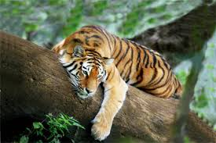
Look At the pictures and discuss with your friends what about the pictures.
These pictures are about our “Nature and Environment”.
Notes:
Teacher will say/discuss the definition of nature and environment.

Slide 5
Today’s Lesson is
On
Nature and environment
(The greed of the roaring rivers)
Lesson Declaration

Slide 6
Learning outcomes
After completing this lesson students will be able….
1) to comprehend and summaries texts.
2) to ask and answer questions.
3) to say the meaning of key words.
4) to take part in debates on given topics.

Slide 7
Let`s watch a video clip
Now discuss with your partner what should we to protect our lives and properties from the river erosion. Then write it within three/four sentences.
Notes:
Teacher can take this answer by orally.

Slide 8
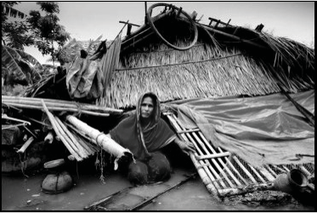
Model reading
Dear students listen the text attentively, then read the text individually and answer the questions that`s have given section B and C.
Notes:
First teacher will read the text, explain the text then ss will read the text loudly/silently later ss answer the ques orally/written.

Slide 9
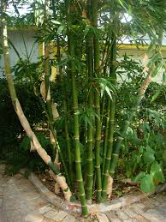
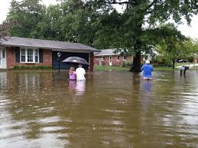
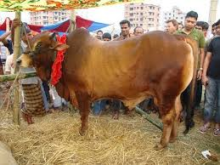
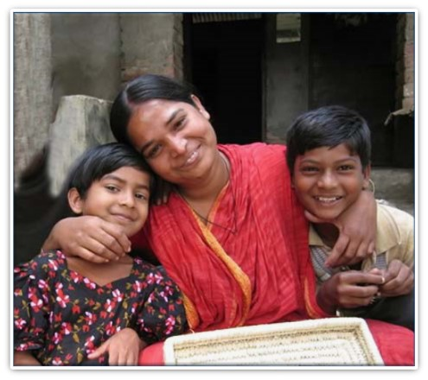
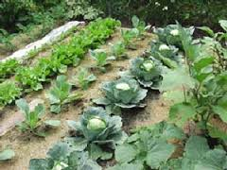
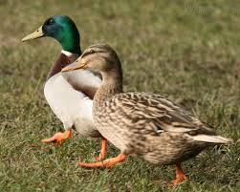
Look at the above pictures and discuss with your partner then write down about the previous life of Meherjan.
Notes:
Teacher can take it orally/written.

Slide 10
Key word
Look at the below word. Try to say the meaning of the word and make a sentence with them.
Erosion
Meherjan lost all her property due to river erosion.
Meaning
(Click here)
The process of eroding or being eroded by wind, water, or other natural agents.
Notes:
At first teacher will show the words then ask his/her students to tell the meaning and making sentences. If they fail teacher will show the picture again. For feedback click on meaning button.

Slide 11
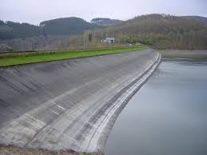
Key word
Look at the below word. Try to say the meaning of the word and make a sentence with them.
Embankment
Meaning
(Click here)
A wall of stone or earth made to keep water back.
Meherjan lives in a slum on the Sirajgong Town Protection Embankment
Notes:
At first teacher will show the words then ask his/her students to tell the meaning and making sentences. If they fail teacher will show the picture again. For feedback click on meaning button.

Slide 12
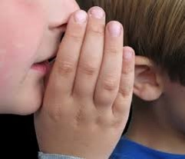
Key word
Look at the below word. Try to say the meaning of the word and make a sentence with them.
Whisper
To speak very quietly to somebody so that other people cannot hear what one is saying
Meaning
(Click here)
The boy whispered me don`t believe a selfish friend.
Notes:
At first teacher will show the words then ask his/her students to tell the meaning and making sentences. If they fail teacher will show the picture again. For feedback click on meaning button.

Slide 13
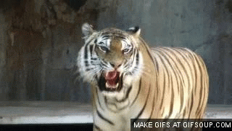
Key word
Look at the below word. Try to say the meaning of the word and make a sentence with them.
Roar
Meaning
(Click here)
To make a loud deep harsh sound of tiger, river or any animals.
The tiger is roaring for hungry.
Notes:
At first teacher will show the words then ask his/her students to tell the meaning and making sentences. If they fail teacher will show the picture again. For feedback click on meaning button.

Slide 14
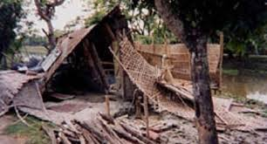
Key word
Look at the below word. Try to say the meaning of the word and make a sentence with them.
Slum
Meaning
(Click here)
A overcrowded urban area inhabited by very poor people.
Meherjan lives in a slum on the Sirajgong Town Protection Embankment
Notes:
At first teacher will show the words then ask his/her students to tell the meaning and making sentences. If they fail teacher will show the picture again. For feedback click on meaning button.

Slide 15

Key word
Look at the below word. Try to say the meaning of the word and make a sentence with them.
Unsteady
Meaning
(Click here)
A libel to fall or shake.
The flame of this candle is unsteady.
Notes:
At first teacher will show the words then ask his/her students to tell the meaning and making sentences. If they fail teacher will show the picture again. For feedback click on meaning button.

Slide 16
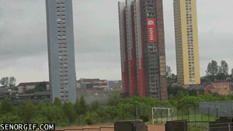
Key word
Look at the below word. Try to say the meaning of the word and make a sentence with them.
Demolish
Meaning
(Click here)
To pull or knock down something.
The greedy Jamuna has demolished Meherjan`s all happiness.
Notes:
At first teacher will show the words then ask his/her students to tell the meaning and making sentences. If they fail teacher will show the picture again. For feedback click on meaning button.

Slide 17
Individual Work
Complete the summery of Meherjan’s life with words/ phrases from the box.
Meherjan is a typical (1)…………….. woman who lives in a slum. She lost her shelter and properties (2)…………….. the erosion of river Jamuna. She also lost her family. Her husband had died of disease caused by poverty and (3)…………………….. . Now, she is only a (4)………………… . Like Meherjan there are many people who have become the (5)…………….. of river erosion. River erosion is still possing (6) ……………… to the lives and properties of thousands of people. People living (7) ………….….. Rivers are most likely victimes of river erosion. Each year about (8) ……………… people become homeless due to river erosion in Bangladesh. Meherjan’s life is just one (9) ………………… of how climate change (10)……………… the lives of thousands of people.
Victims, affects, close to, slum dweller, homeless, Threats, example, due to, shortage of food, one lakh
homeless
due to
shortage of food
slum dweller
victims
threats
close to
one lakh
example
affects
Notes:
SS will get time 10 minu: T will try to elicit the ans: from ss if fail then T will give feedback.

Slide 18
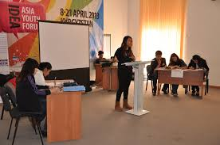
Get into two groups of 3/4. Decide which group will speak for/against the motion. In your group, first discuss and note down 5/6 points to support/oppose the statement below. Then select the speakers from each group to start the debate.
Statement: Human can’t do anything to control the course of nature.
Notes:
Teacher can arrange the debate next class but today h/s will give dictation about the debate.

Slide 19
Evaluation.
Choose the best answer
1.What does adapt mean ?
a)adjust b) unchanged c) chaos d) dam
2. Embankment represents ………………….
a) dam b) river c) Erosion d) quiver
3. The river Jamuna has consumed
a) the cultivable land b) houses
c) bamboo bush of Meherjan d) all of the above answers.
Solutions
a
b
c
Notes:
T will try to elicit the ans: from ss if fail then T will give feedback.

Slide 20

Home Works
Write ten sentences about merit and demerits of flood.

Slide 21
Acknowledgement
We would like to express our cordial gratitude to the Ministry of Education, Directorate of Secondary & Higher Education, NCTB, a2i
and
the panel of honorable editors ( Md. Jahangir Hasan, Associate Professor (English) TTC, Rangpur, Ranjit Poddar, Associate Professor (English) TTC, Dhaka, and Urmila Ahmed, Associate Professor (English) TTC, Dhaka, to enrich the contents.

Slide 22


